Slide 1
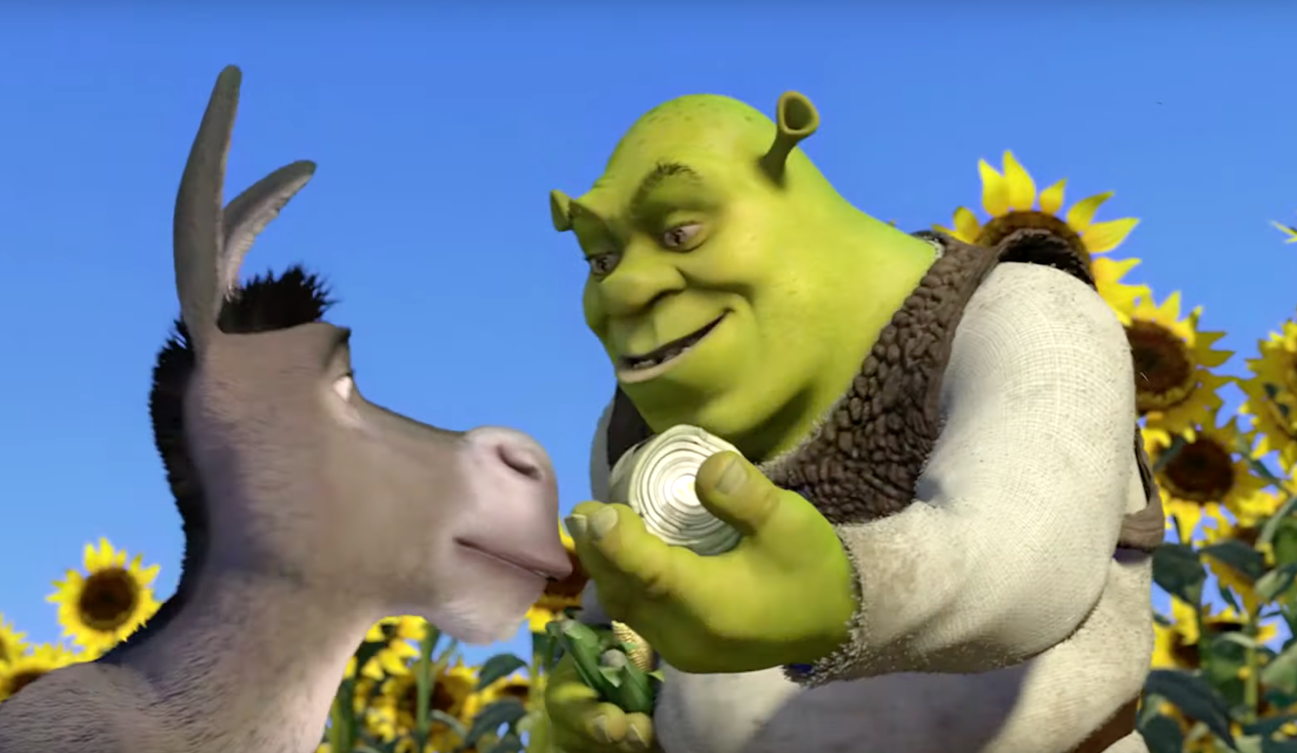
OCI Images
Joey Brown

Slide 2
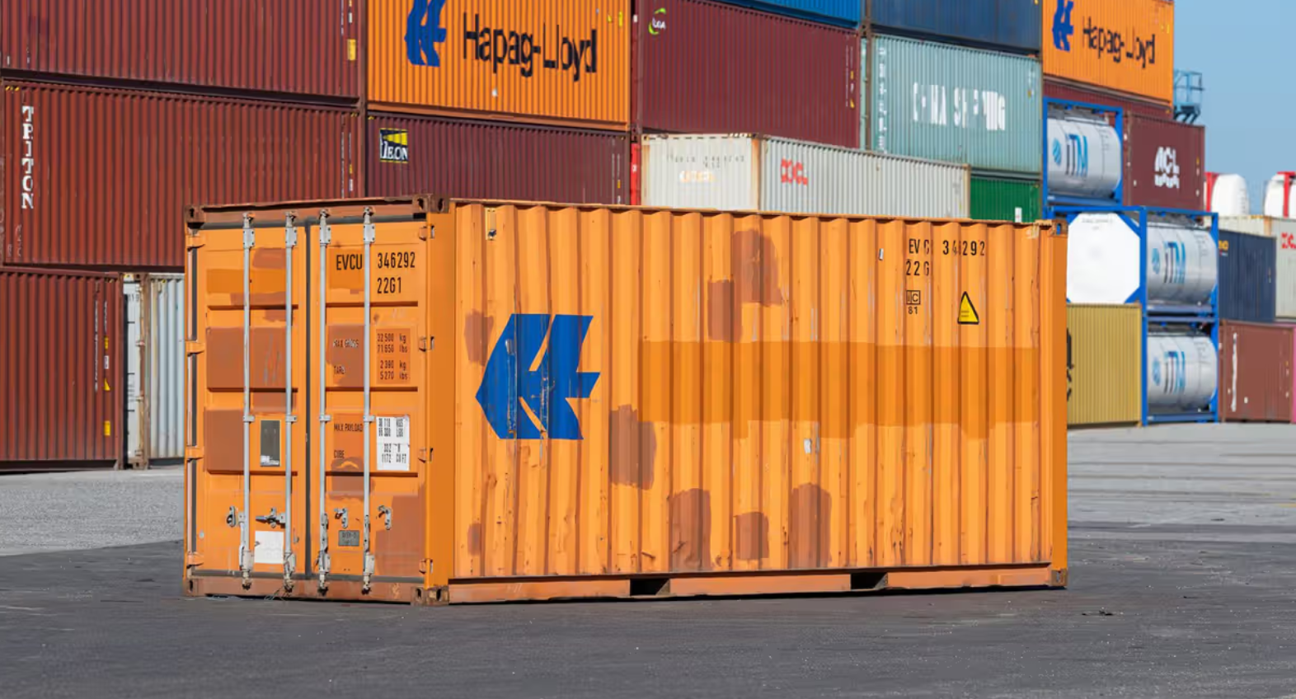
Build, distribute, run software

Slide 3


Open Container Initiative
Image Specification
Distribution Specification
Runtime Specification
https://docker.io
https://opencontainers.org
https://github.com/OpenContainers
Notes:
Docker established OCI in 2015

Slide 4
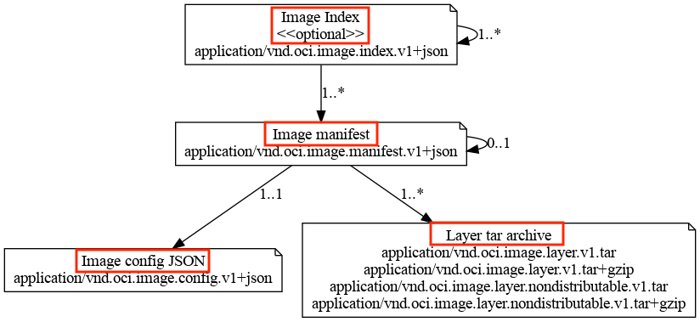
image-spec
https://github.com/opencontainers/image-spec/blob/main/img/media-types.png

Slide 5
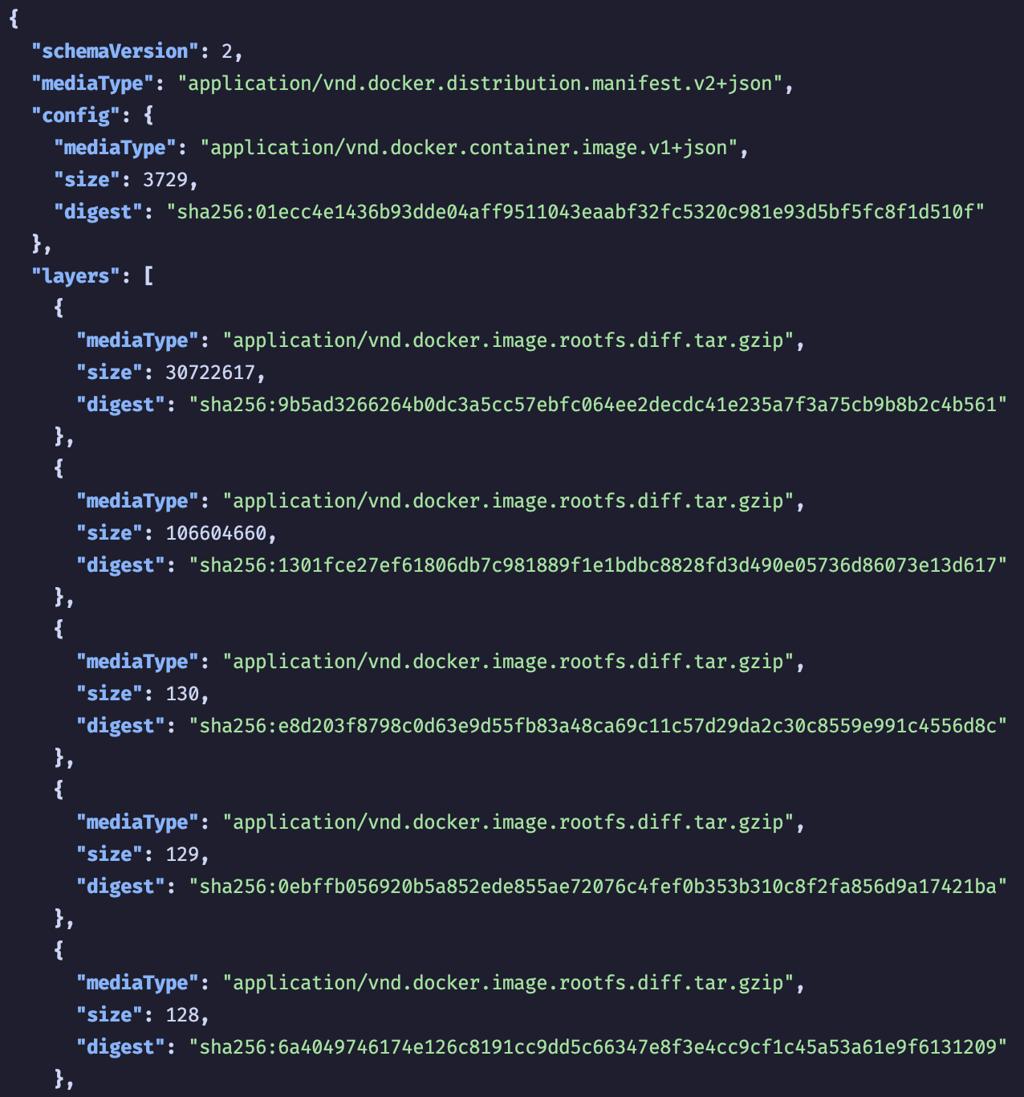
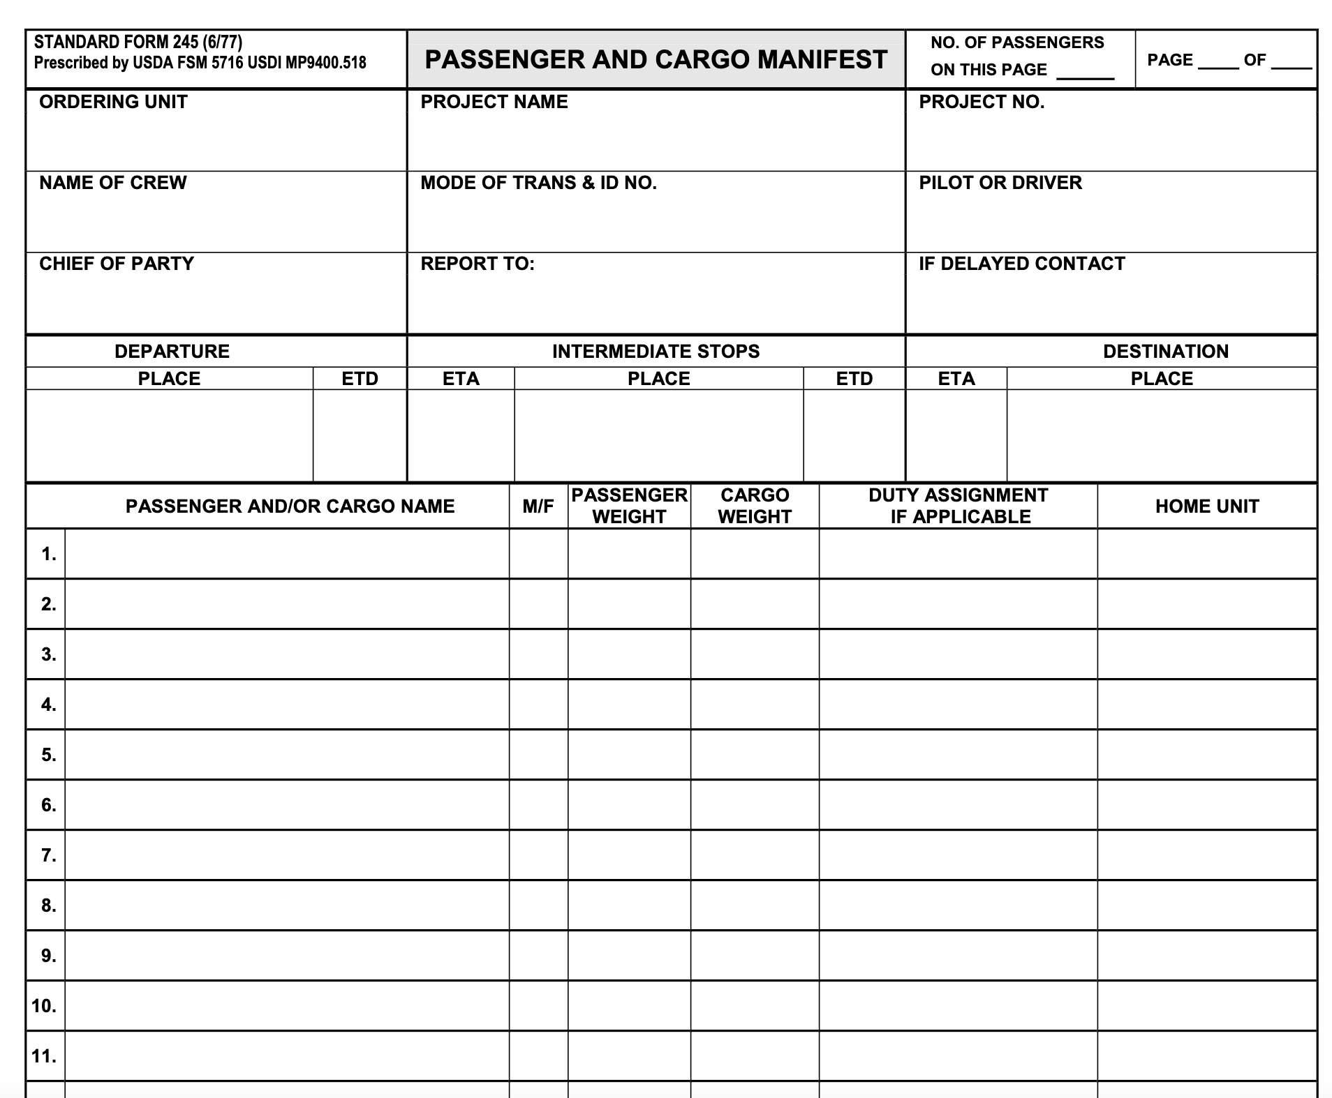
image-spec manifest

Slide 6
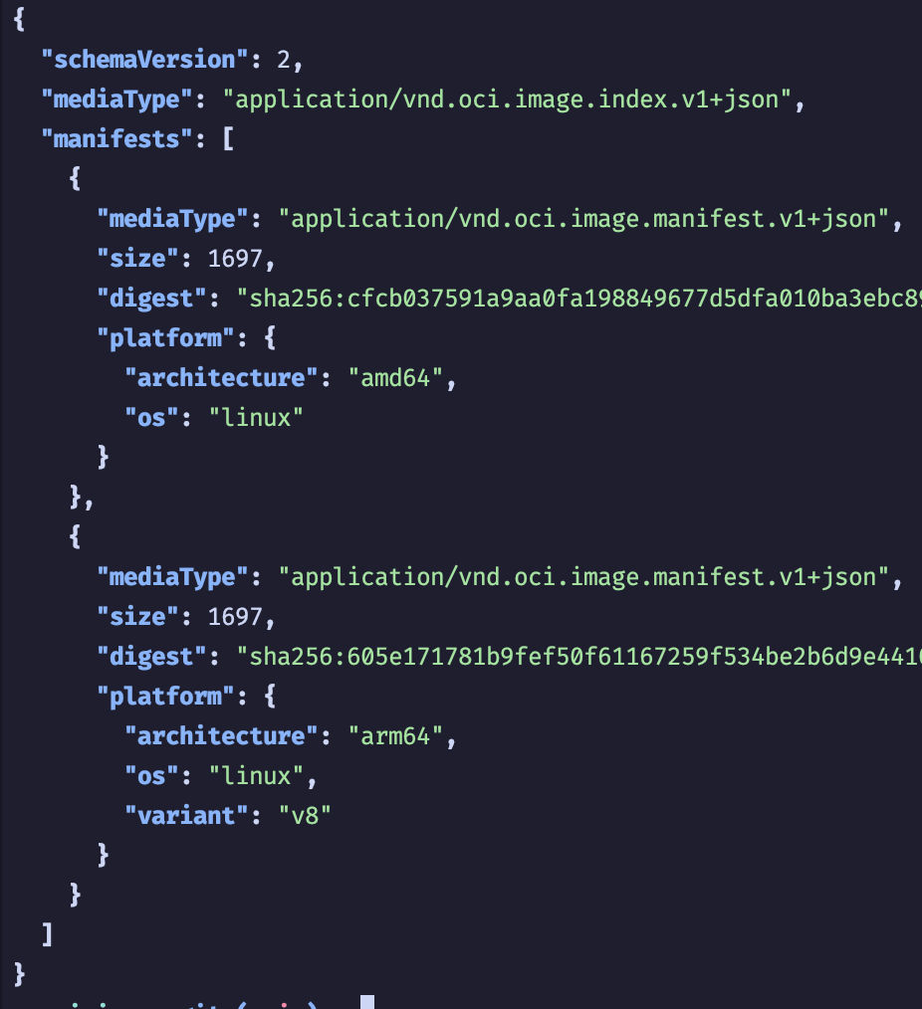
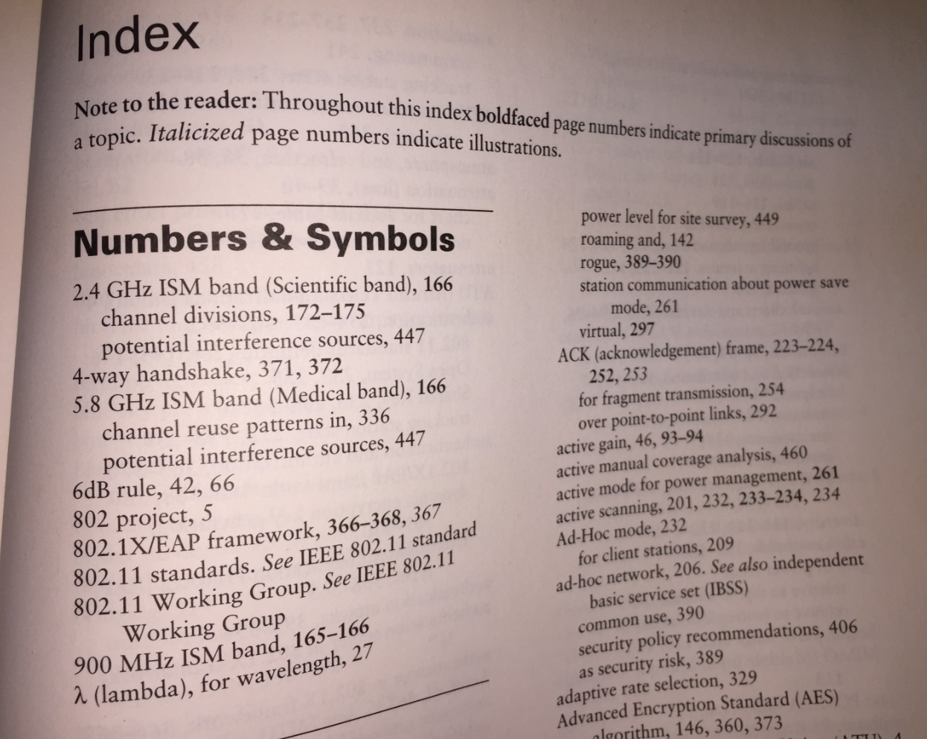
image-spec index

Slide 7
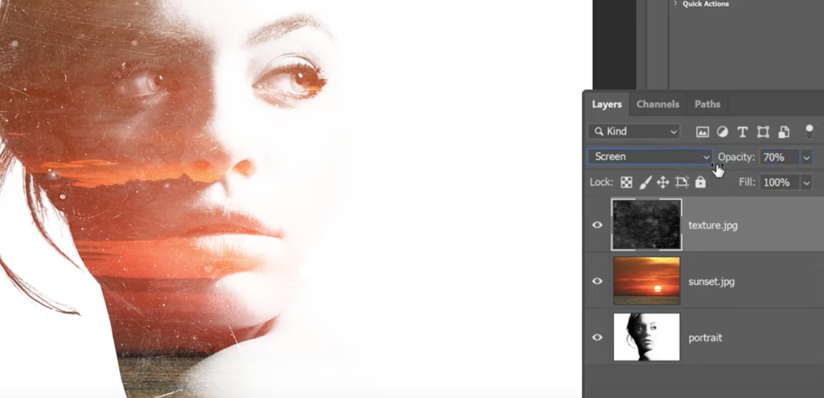
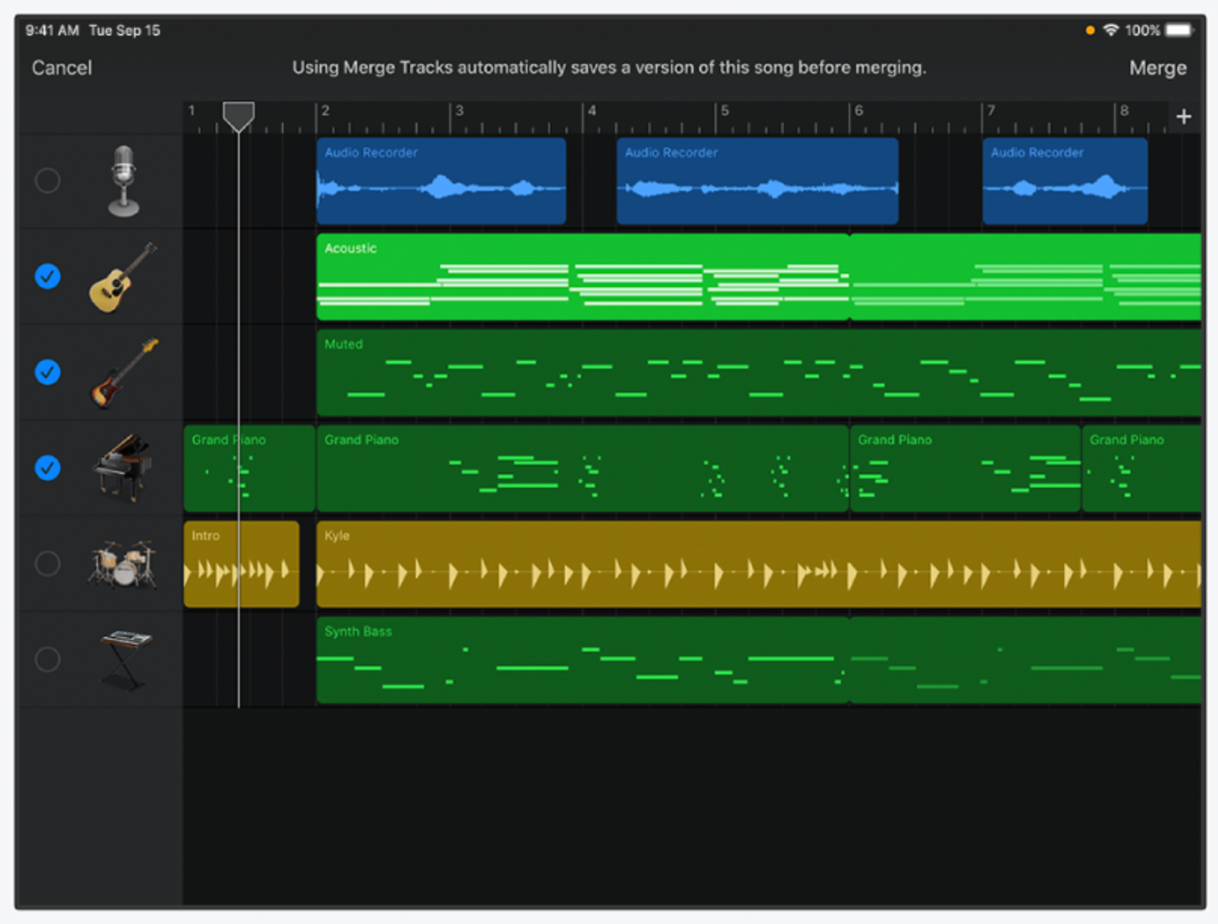
image-spec layer

Slide 8
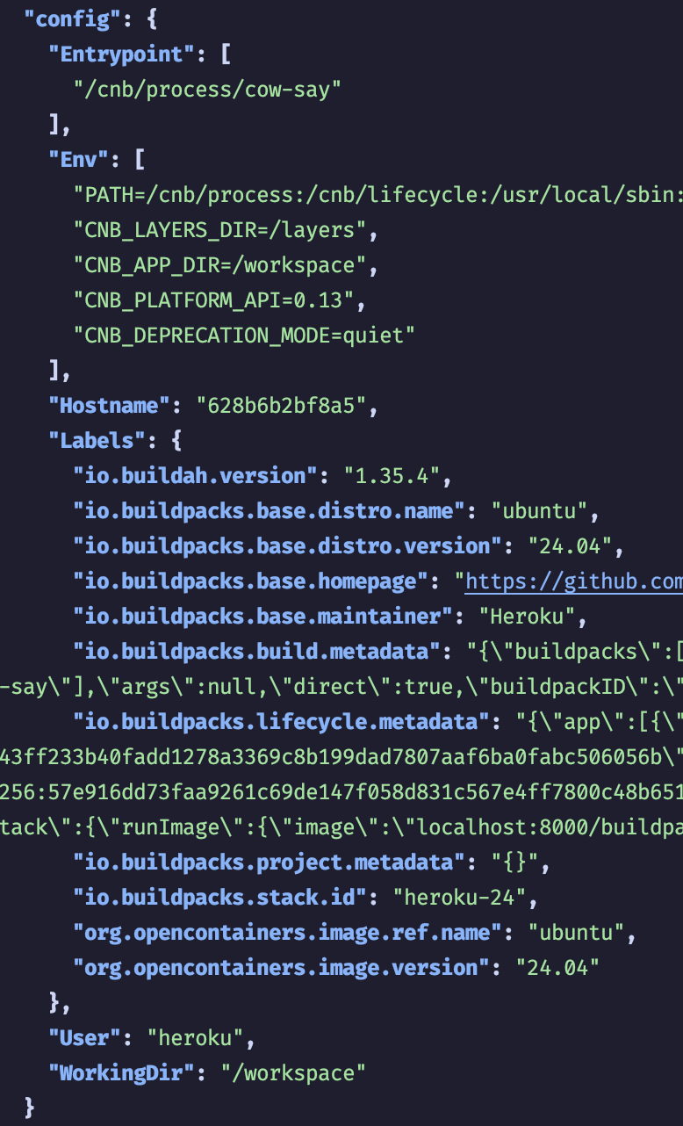

image-spec config

Slide 9
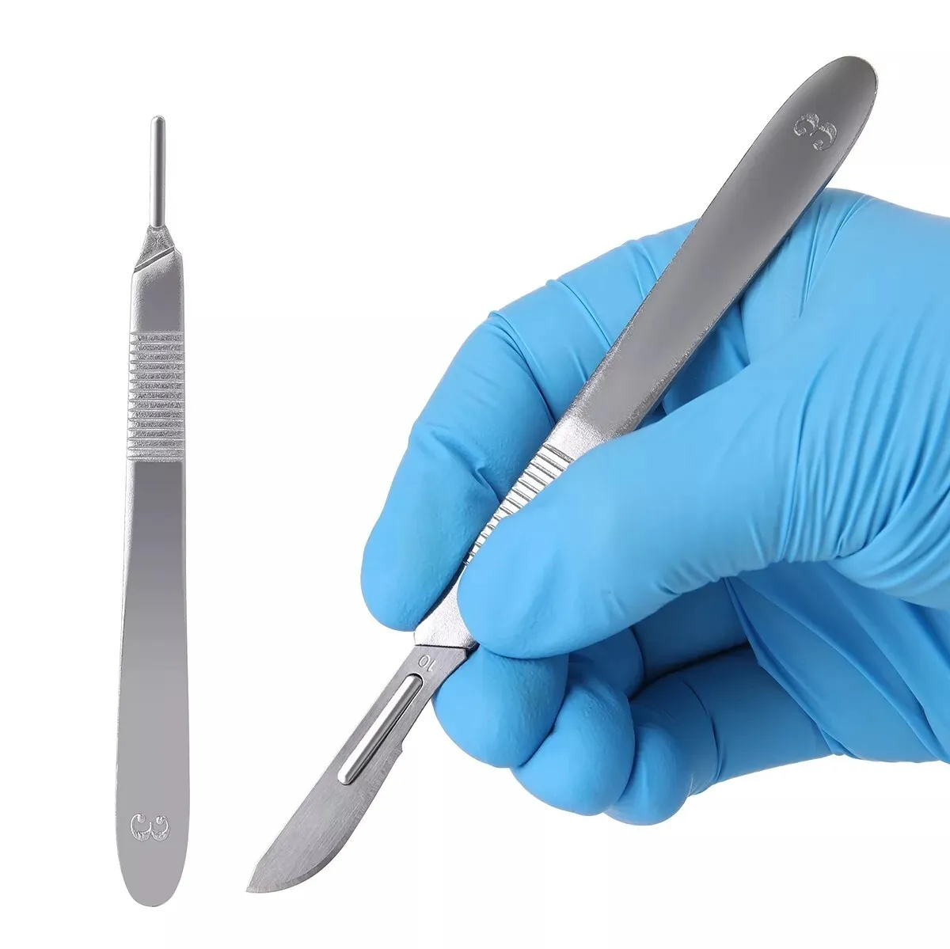
Image Introspection
crane
https://github.com/google/go-containerregistry/tree/main/cmd/crane
dive
https://github.com/wagoodman/dive
oras
https://github.com/oras-project/oras
Notes:
Introduce the demo app

Slide 10

Demo #1 Containerfile
Goal: Gain deeper insight by visualizing real image parts
Actions: Build an image and use tools to peruse it

Slide 11


distribution-spec

Slide 12
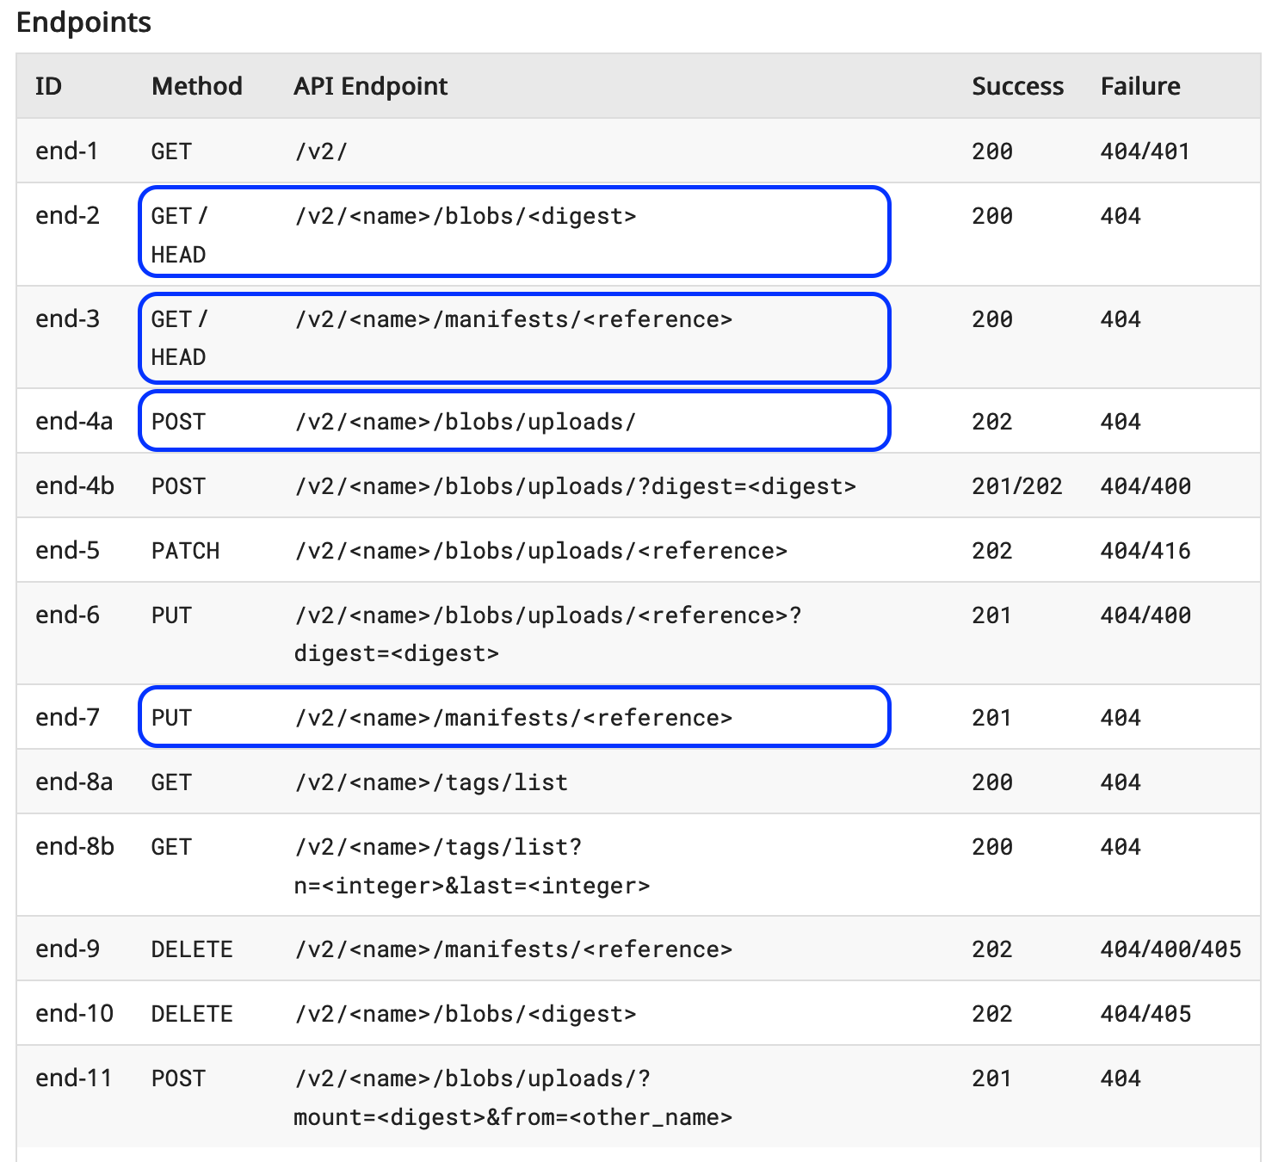
distribution-spec
https://specs.opencontainers.org/distribution-spec/?v=v1.0.0#endpoints

Slide 13

Demo #2 Crane append & ko build
Goal: Visualize the registry capabilities
Actions: Build images (without running containers) and use tools to peruse them

Slide 14
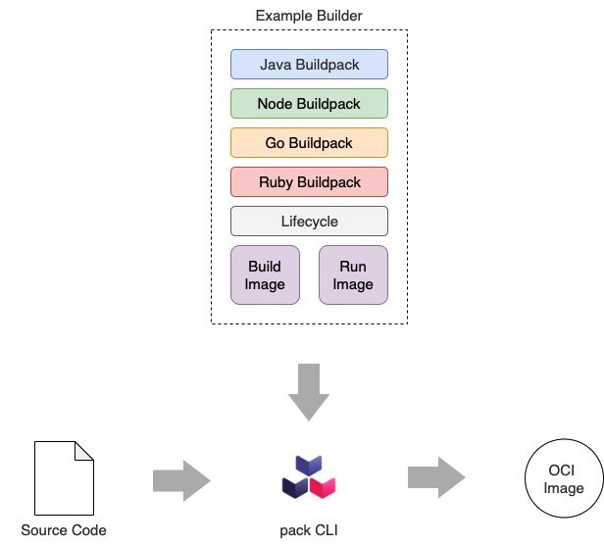
Demo #3 buildpacks
Goal: Visualize a novel way to build images
Actions: Build & rebase images
https://buildpacks.io

Slide 15

Review

Slide 16
distribution-spec
The OCI Distribution Specification (this project) is also designed generically enough to be leveraged as a distribution mechanism for any type of content. The format of uploaded manifests, for example, need not necessarily adhere to the OCI Image Format Specification so long as it references the blobs which comprise a given artifact.

Slide 17

Arbitrary Artifact Distribution

Slide 18



OCI Artifacts
Community Buildpacks
Helm Charts
WASM Modules

Slide 19
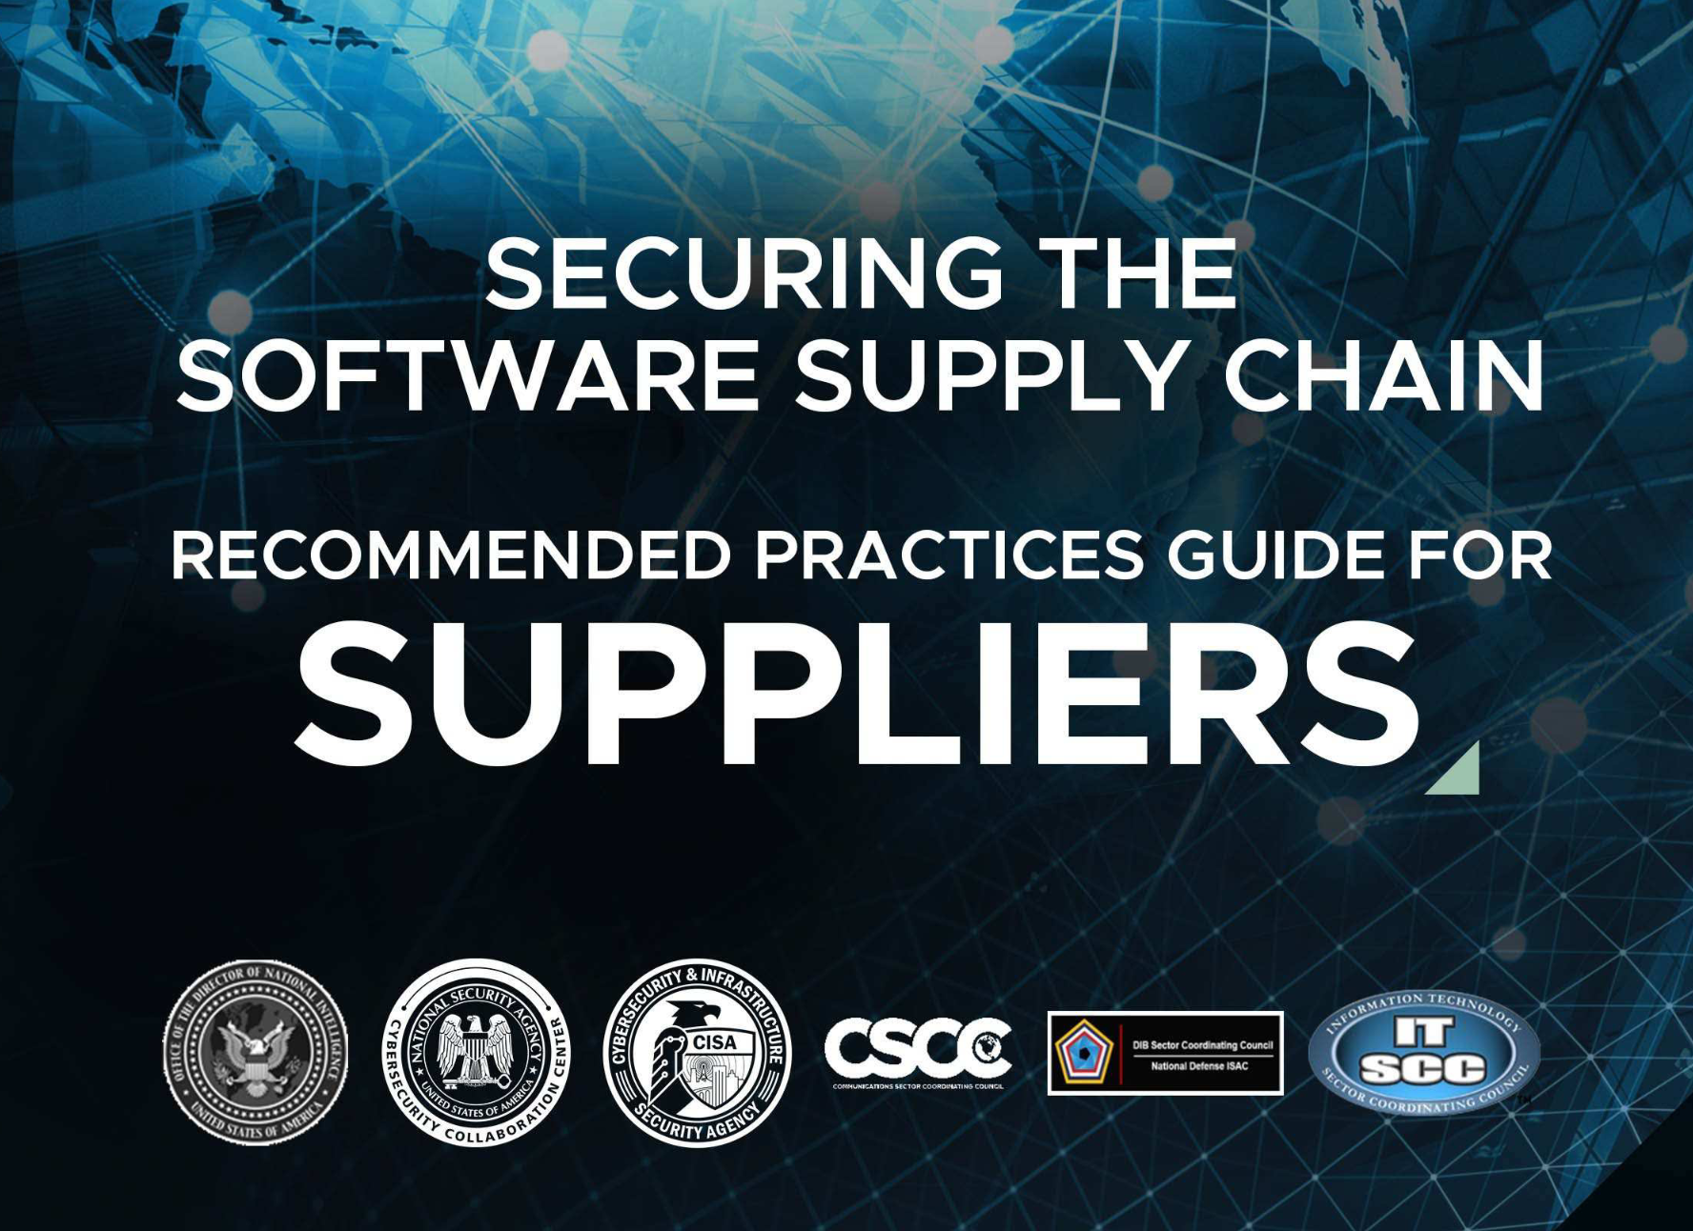
OCI Artifacts – Image Attachments
Image Signatures
Software Bill of Materials
Provenance Attestations

Slide 20


OCI Artifacts
https://oras.land
https://docs.sigstore.dev

Slide 21
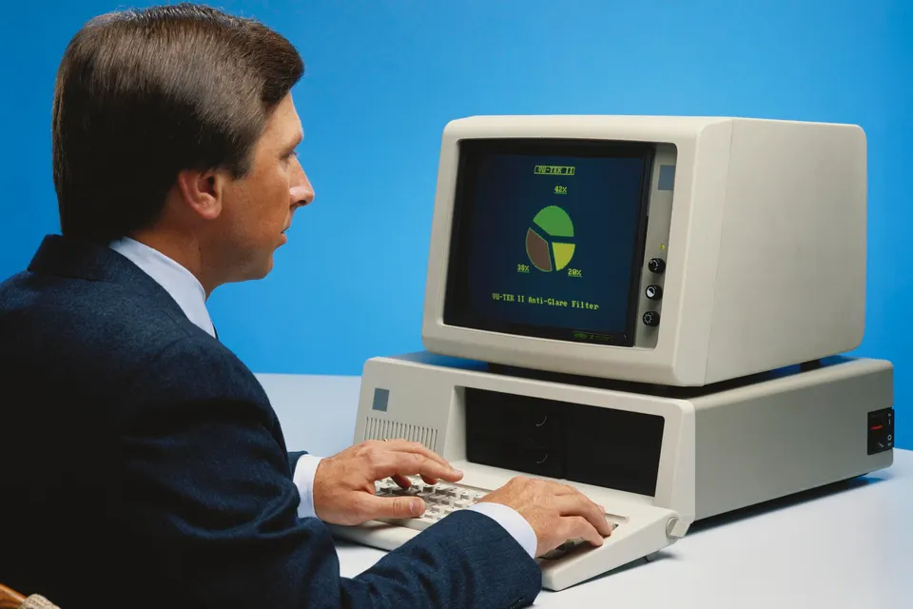
Demo #4 Artifacts & Attachments
Goal: Visualize registry flexibility
Actions: Store artifacts & attach objects

Slide 22


